Slide 1
Building Value-Laden Technology With (and Using) AI
Ken Arnold
Calvin University
May these words of my mouth and this meditation of my heart
be pleasing in your sight,
Lord, my Rock and my Redeemer. (Psalm 19:14)
Notes:
Audience: technologists with some AI experience who want to use AI more wisely.
Intent: get them thinking about wisdom as beyond just capabilities; get users for Thoughtful and collaborators for project-based service learning
Message: ask not what AI can do for you, but what you aim to achieve, what AI should be kept from doing to help you, and who else you can welcome in to the journey

Slide 2
Genesis 1 (NIV)
In the beginning God created the heavens and the earth. Now the earth was formless and empty, darkness was over the surface of the deep, and the Spirit of God was hovering over the waters.
And God said, “Let there be light,” and there was light. God saw that the light was good, and he separated the light from the darkness. God called the light “day,” and the darkness he called “night.” And there was evening, and there was morning—the first day.
And God said, “Let there be a vault between the waters to separate water from water.” So God made the vault and separated the water under the vault from the water above it.
And it was so. God called the vault “sky.” And there was evening, and there was morning—the second day.
And God said, “Let the water under the sky be gathered to one place, and let dry ground appear.” And it was so. God called the dry ground “land,” and the gathered waters he called “seas.” And God saw that it was good.
Then God said, “Let the land produce vegetation: seed-bearing plants and trees on the land that bear fruit with seed in it, according to their various kinds.”
And it was so. The land produced vegetation: plants bearing seed according to their kinds and trees bearing fruit with seed in it according to their kinds. And God saw that it was good. And there was evening, and there was morning—the third day.
And God said, “Let there be lights in the vault of the sky to separate the day from the night, and let them serve as signs to mark sacred times, and days and years, and let them be lights in the vault of the sky to give light on the earth.”
And it was so. God made two great lights—the greater light to govern the day and the lesser light to govern the night. He also made the stars. God set them in the vault of the sky to give light on the earth, to govern the day and the night, and to separate light from darkness. And God saw that it was good. And there was evening, and there was morning—the fourth day.
And God said, “Let the water teem with living creatures, and let birds fly above the earth across the vault of the sky.” So God created the great creatures of the sea and every living thing with which the water teems and that moves about in it, according to their kinds, and every winged bird according to its kind. And God saw that it was good. God blessed them and said, “Be fruitful and increase in number and fill the water in the seas, and let the birds increase on the earth.” And there was evening, and there was morning—the fifth day.
And God said, “Let the land produce living creatures according to their kinds: the livestock, the creatures that move along the ground, and the wild animals, each according to its kind.” And it was so. God made the wild animals according to their kinds, the livestock according to their kinds, and all the creatures that move along the ground according to their kinds. And God saw that it was good.
Then God said, “Let us make mankind in our image, in our likeness, so that they may rule over the fish in the sea and the birds in the sky, over the livestock and all the wild animals, and over all the creatures that move along the ground.”
So God created mankind in his own image,
in the image of God he created them;
male and female he created them.

Slide 3
Building Tech with AI
Who has built something with AI help?
What makes the result good?
Have other people used what you built? What would change?

Slide 4
Three Questions
Targets: What objective?
Fences: What should AI not do?
Who?
Notes:
I’ll say more about the “Who” question at the end. But first a quick intro on Targets and Fences.

Slide 5
Targets? Optimization Games
Big machine make number go big.
Performative intelligence
Goodhart’s Law
For the time will come when people will not put up with sound doctrine. Instead, to suit their own desires, they will gather around them a great number of teachers to say what their itching ears want to hear. They will turn their ears away from the truth and turn aside to myths. [2 Timothy 4:3-4, NIV]

Slide 6

Thoughtful AI
Instead, be Thoughtful:
  AI challenges, visualizes, simulates how readers will react… writer thinks.
Student researchers implemented as a Word and Google Docs sidebar
Default mode: AI generates, writer appropriates.
Sloppy (“it’s not X, it’s Y”), unloving — requires readers to discern
Premature closure: you stopped thinking before getting to the good part
https://app.thoughtful-ai.com
Notes:
Words are powerful. So embrace the complexity of writing.
HBR article: “AI-generated Workslop is Destroying Productivity”

Slide 7
Targets in Writing
Writing with ChatGPT
Thoughtful writing
Efficiency (get it done fast)
Performative (RLHF feedback signal)
  output looks better, sounds fluent, makes me sound smart
Loving your reader.
Thinking holistically about the situation.
Hard to quantify and optimize thoughtfulness. (My research team may have finally figured out one approach.)

Slide 8
What should AI not do in writing?
And how can we enforce that?

Slide 9
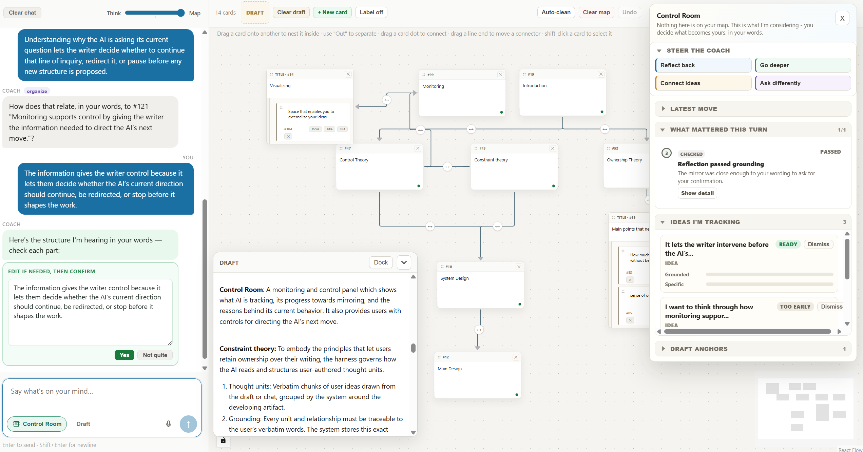

Slide 10
Fences in Writing
Mindmap / Own Words: AI doesn’t originate.
Limitations on:
Phrasing: harness rejects edits that aren’t quotes from you.
  you can tell AI today: “must be direct quotes from me”
Ideas / relationships
Information (bits) (currently exploring with another project team)

Slide 11
Fences
Beyond personal boundaries (I don’t ask AI to write; or no-chatbot Sundays)
Harness: what allows an LLM to act. Enforces boundaries.
When agents “go rogue”, this is the failure point.
Context
draft + “Use only my words”
asked, not enforced
Fence: rejects edits that aren’t your words
enforced
Model
Reads text,
writes text
Harness
Builds the context,
checks the request,
performs the action
Your
document
“Replace ¶2 with: …”
Other fences:
sandboxes, access controls, approvals, limited actions
A request, not an action

Slide 12
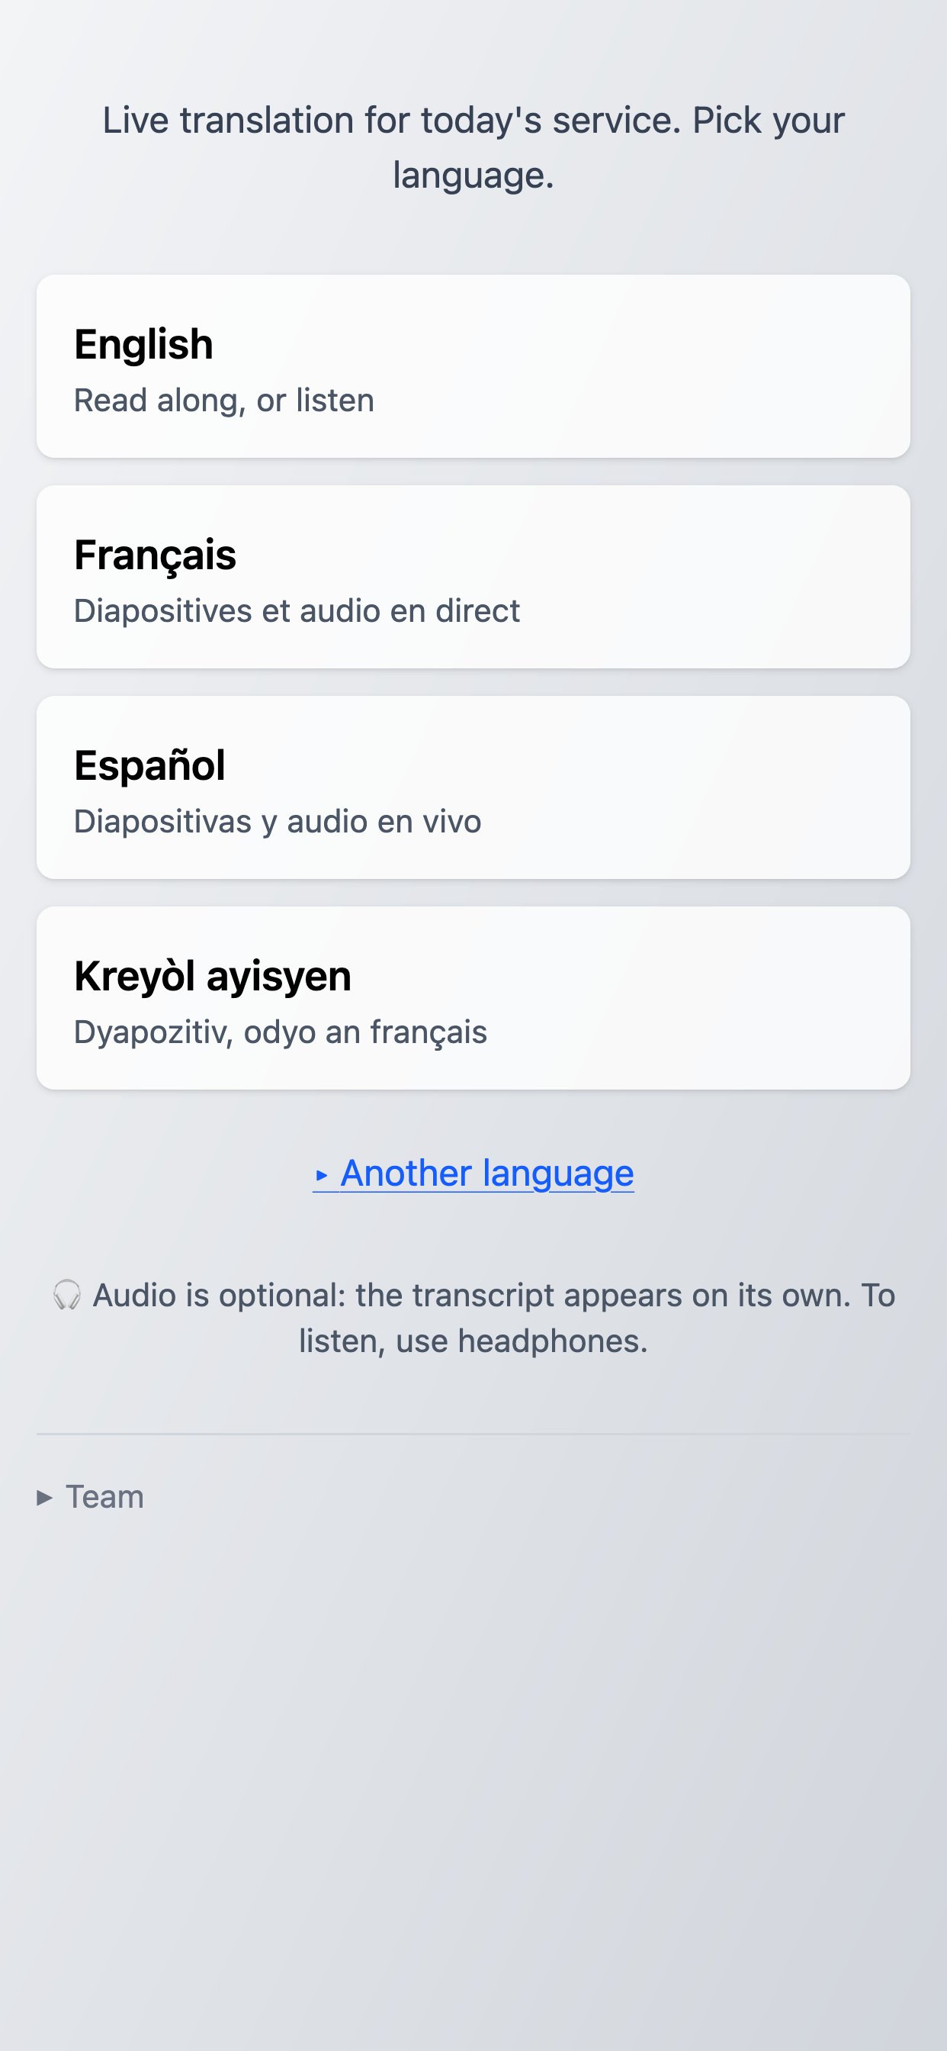
From Every Language
Linguistic accessibility: any person walking in should be able to hear the “wonders of God in their own languages” (Acts 2)
Live translation system for my church (and eventually others): translate slides, speech, and sermon notes

Slide 13
From Every Language: Targets and Fences
Success?
AI generated code that ensured “translations are available”
I had to do lots of engineering to ensure “system runs reliably without me”, “everyone can access”, …
Still growing in: “translations are culturally appropriate”, …
Fences
AI should not write Scripture; looks it up instead (but this was prompted, not harness-fenced… so it still sometimes does invent)

Slide 14
From Every Language: Looking Up Scripture
The model can misquote Scripture, so it asks for the verse instead.
Harness: what allows an LLM to act. Here it fetches the real text.
Context
Acts 2:11 text, from the RVR
retrieved, not remembered
Lookup: harness fetches the verse
exact published wording
Model
Reads text,
writes text
Harness
Builds the context,
checks the request,
looks up the verse
Bible text
published
translations
“Look up Acts 2:11, RVR”
Other data sources:
Creeds/confessions, sermon notes, earlier translations
A request for data

Slide 15
Course Materials
I used Claude Code (a coding agent) to help align my course with learning objectives.
Lots of context: can look across the whole course.
Helped refine objectives, tag activities, revise activities to better address objectives
Target? Focusing on assessable objectives meant I over-valued what was easily automatable.
Fences? Insufficient. Students got some slop.

Slide 16
Who Builds Technology?
People are now building software for their own organizations.
But design and engineering still needed!
Opportunity for education: project-based service learning
  AI means we need learning by doing—but it also enables it.
  But it’s not native in most of our educational institutions.
  Let’s figure out together how students could learn about God’s world by using AI to help them serve their neighbors.
In every situation, do AI together.
Notes:
Thoughtful and EveryLang have been big learning experiences for me, even as a software engineer with decades of experience. Has involved a dozen or so students.

Slide 17
AI in Teaching and Learning
How might cognitive tools help guide groups (of students, faculty, institutions, etc.) to pursue long-term, open-ended, highly collaborative goals?
How I use AI in teaching (high-context, alignment, …).
AI for team project coaching?

Slide 18
Wrap-Up
Three examples:
Thoughtful AI in writing
From Every Language translation in worship
Revising course materials
Three questions
What’s success?
What should AI be kept from doing?
Who can build technology?
One call: planning a gathering for educators on project-based service learning.
https://kenarnold.org/wisdom2026/

